Slide 1

Systems Analysis & Design

Slide 2
Architectural Design

Slide 3
INTRODUCTION
Architecture design
  Plans for how the system will be distributed across multiple computers and what hardware, operating system software, and application software will be used for each computer.
Key factors in architecture design
  Nonfunctional requirements developed early in the analysis phase play a key role in architecture design.
Hardware and software specification
  Defines what hardware and software are needed for the new system.

Slide 4
ELEMENTS OF AN ARCHITECTURE DESIGN
The objective of architecture design is to determine how the software components of the information system will be assigned to the hardware devices of the system.

Slide 5
Architectural Components
The major architectural components of any system are the software and the hardware.
All software systems can be divided into four basic functions:
- Data storage.
  - Data access logic: the processing required to access stored data.
  - Application logic: the logic documented in the use cases, and functional requirements.
- Presentation logic: the display of information to the user and the acceptance of the user’s commands.
Notes:
https://teachcomputerscience.com/client-server-architecture/

Slide 6
(cont’d)
The three primary hardware components:
- Client computers: Input-output devices employed by users (e.g., PCs, laptops, handheld devices, smart phones)
- Servers: Larger multi-user computers used to store software and data.
- The network: Connects the computers.

Slide 7
Client-Server Architectures
Client-server architectures balance the processing between client devices and one or more server devices.
The client is responsible for the presentation logic, whereas the server is responsible for the data access logic and data storage.
Notes:
https://techterms.com/definition/client-server_model

Slide 8
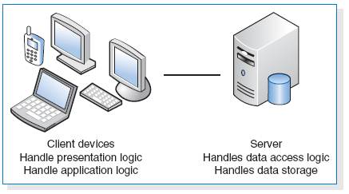
(cont’d)

Slide 9
(cont’d)
Client-server architectures have four important benefits.
- Scalable : easy to increase or decrease the storage and processing capabilities of the servers
- Can support different types of clients and servers through middleware (type of system software designed to translate between different vendors’ software.)
- The presentation logic, the application logic, and the data processing logic can be independent.
- If a server fails, only the applications requiring that sever are affected.
The major limitation of client-server architectures is their complexity.

Slide 10
Advances in Architecture Configurations
Advances in hardware, software, and networking have given rise to a number of new architecture options.
- Virtualization.
- Cloud computing.

Slide 11
Virtualization
Virtualization refers to a creation of a virtual device or resource, such as a server or storage device.
Server virtualization involves partitioning a physical server into smaller virtual servers.
Storage virtualization involves combining multiple network storage devices into what appears to be single storage unit.

Slide 12
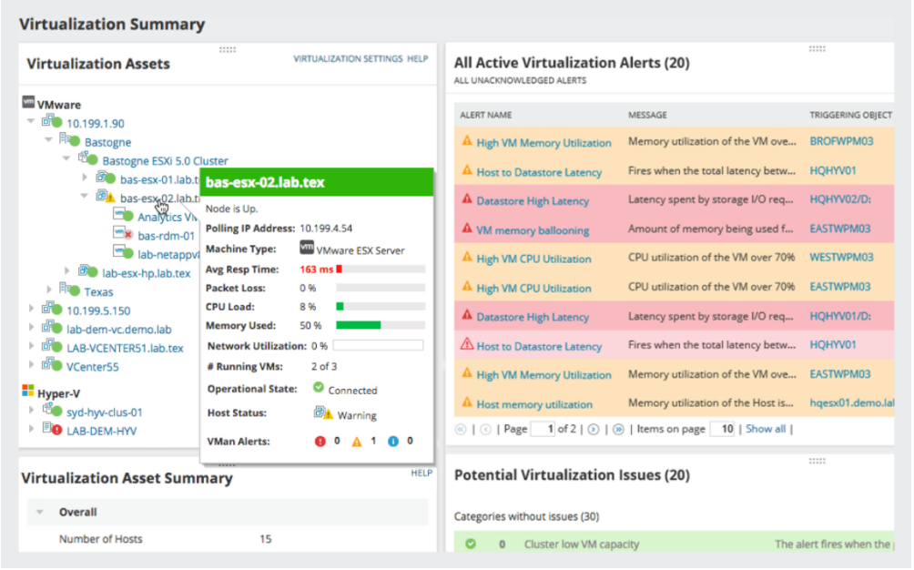

Slide 13
Cloud Computing
Cloud computing – everything from computing power to computing infrastructure, applications, business processes to personal collaboration can be delivered as a service wherever and whenever needed.
The “cloud” can be defined as the set of hardware, networks, storages, devices, and interfaces that combine to deliver aspects of computing as a service.

Slide 14
(cont’d)
Cloud computing can be implemented in three ways:
- private cloud,
- public cloud, and
- hybrid cloud.
At this time, cloud computing is in its early stage of development.

Slide 15
(cont’d)
Advantages of cloud computing
1. The resources allocated can be increased or deceased based on demand.
2. Cloud customers can obtain cloud resources in a straightforward fashion.
3. Cloud services typically have standardized APIs (application program interfaces).
4. The cloud computing model enables customers to be billed for resources as they are used.

Slide 16
CREATING AN ARCHITECTURE DESIGN
Creating an architecture design begins with the nonfunctional requirements.
Refine the nonfunctional requirements into more detailed requirements for the selection of architecture.
The nonfunctional requirements and the architecture design are used to develop the hardware and software specification.

Slide 17
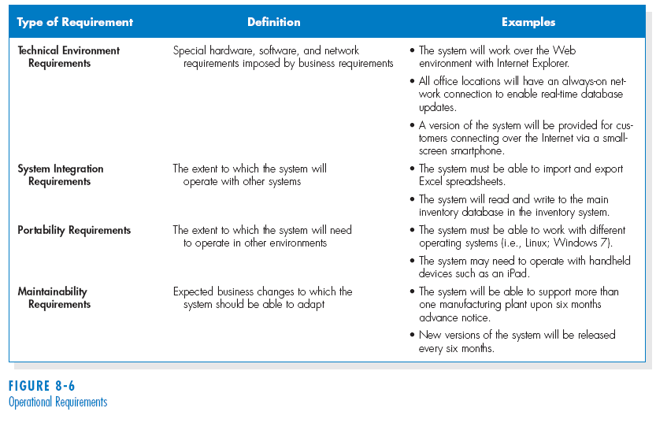
Operational Requirements

Slide 18
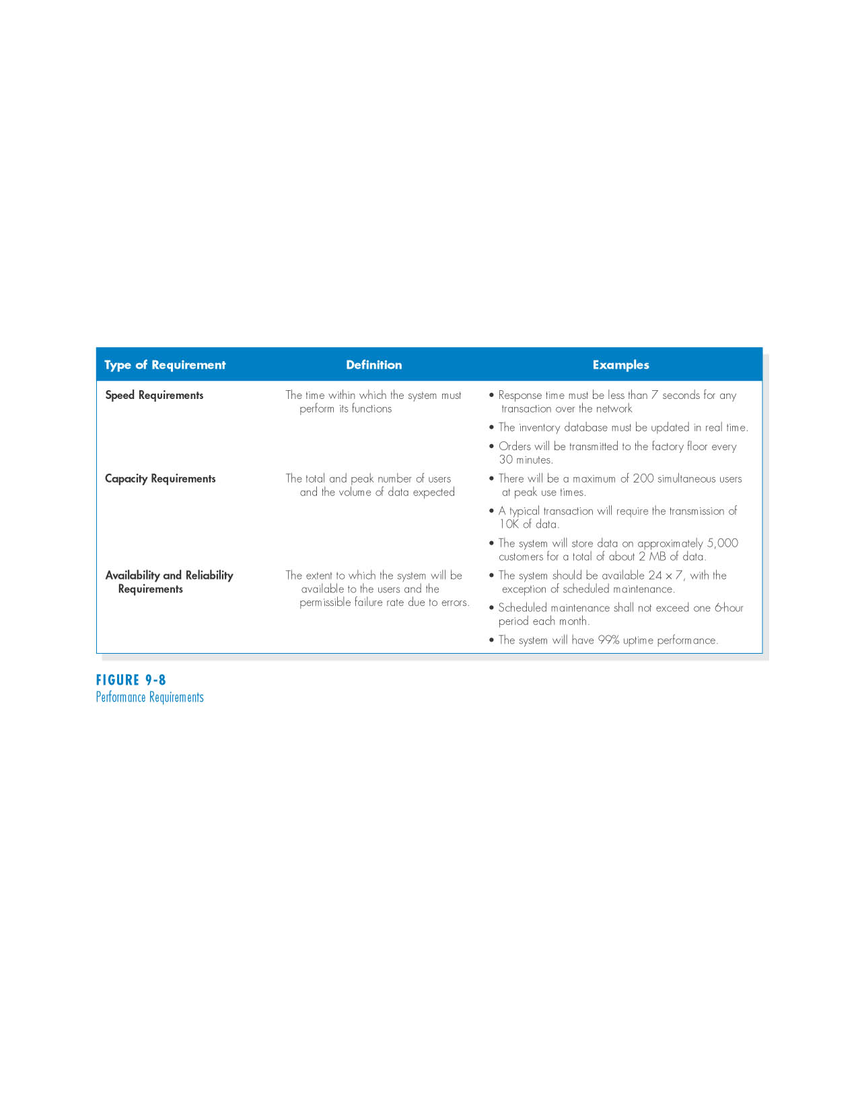
Performance Requirements

Slide 19
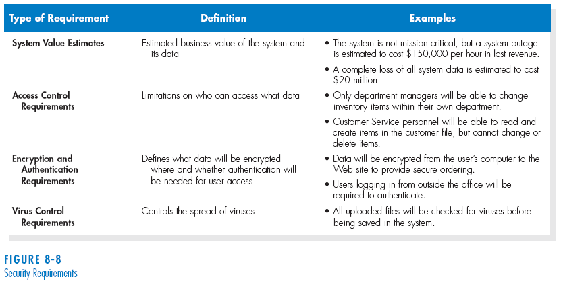
Security Requirements

Slide 20
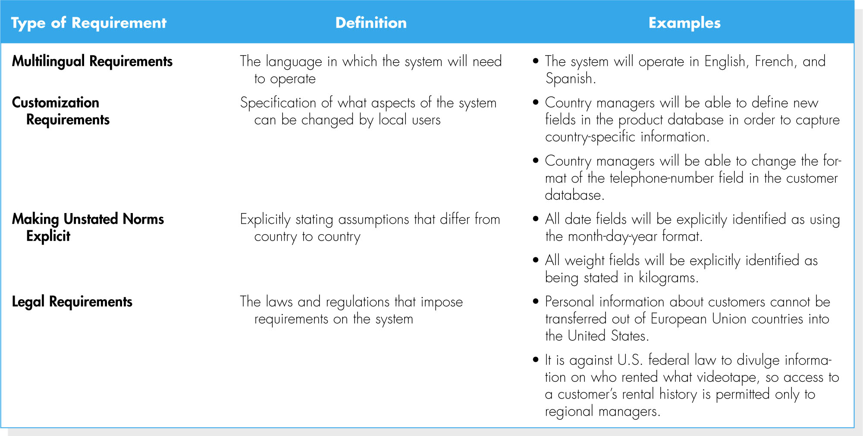
Cultural and Political Requirements

Slide 21
Designing the Architecture
In many cases, the technical environment requirements as driven by the business requirements define the application architecture.
If the technical environment requirements do not require the choice of a specific architecture, then other nonfunctional requirements become important for designing the architecture.

Slide 22
HARDWARE AND SOFTWARE SPECIFICATION
The design phase is also the time to begin selecting and acquiring the hardware and software that will be needed for the future system.
The hardware and software specification is a document that describes what hardware and software are needed to support the application.

Slide 23
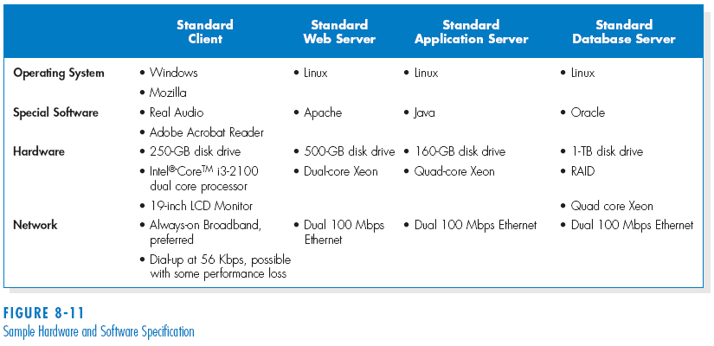
(cont’d)
Sample hardware and software specification

Slide 24
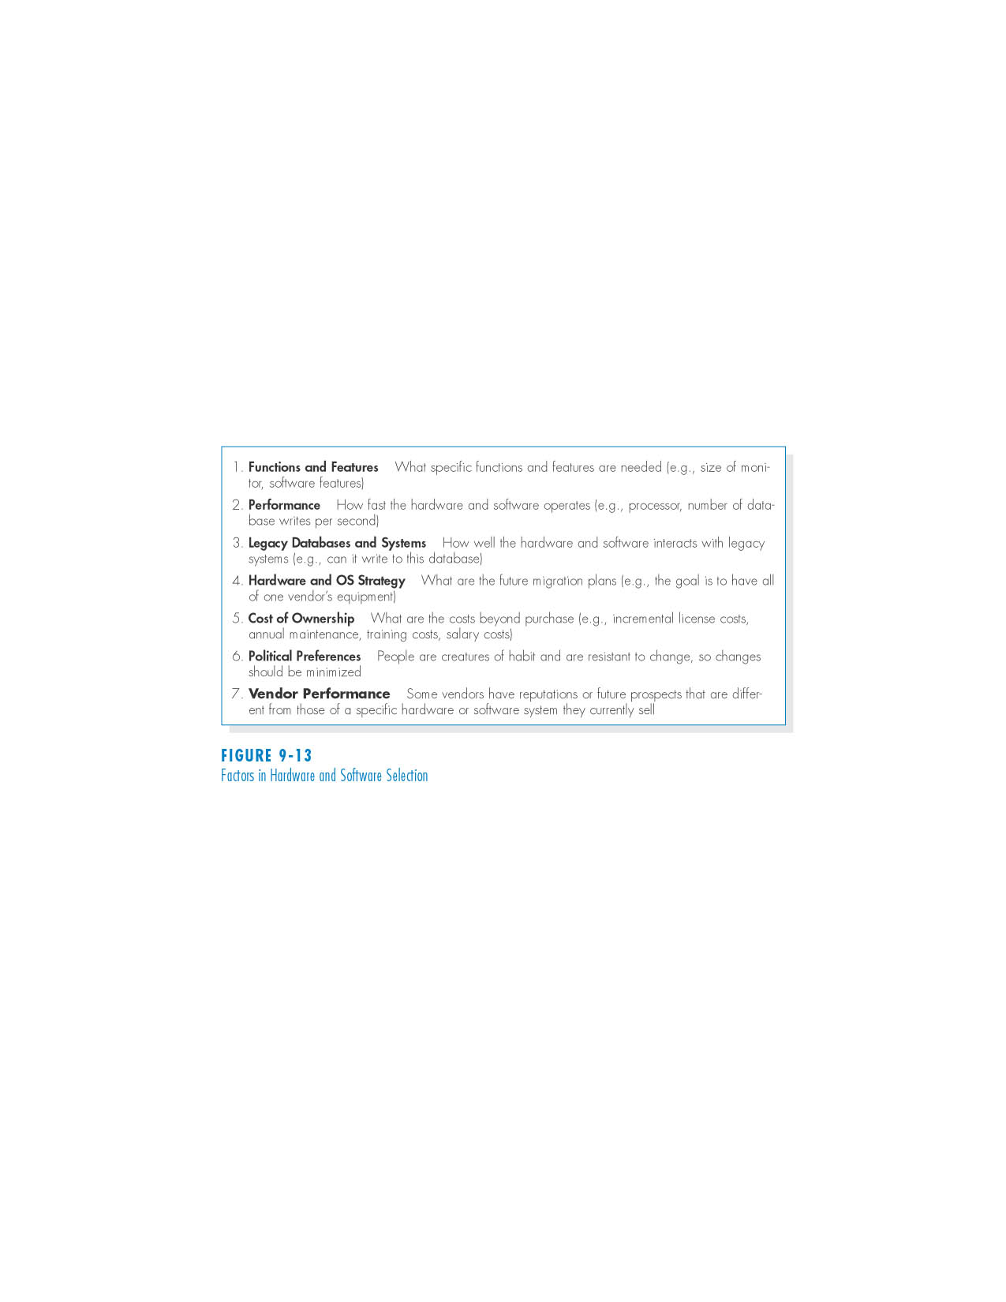
(cont’d)
Factors in hardware and software selection

Slide 25
SUMMARY
Application architecture.
- Client-server architecture.
- Advances in architecture configurations: virtualization and cloud computing.
Architecture Design.
- Nonfunctional requirements.
Hardware and software specification.
- A document that describes what hardware and software are needed to support the application.

Slide 26
User Interface Design

Slide 27
INTRODUCTION
Interface design is the process of defining how the system will interact with external entities.
We focus on the design of user interfaces – how the system will interact with the users.
The design of system interfaces defines how the systems exchange information with other systems.

Slide 28
(cont’d)
The user interface includes three fundamental parts:
- The Navigation mechanism - the way in which the user tells the system what to do.
- The input mechanism – the way in which the system captures information.
- The output mechanism - the way in which the system provides information to the user or to other systems.
Graphical user interfaces (GUI) use windows, menus, icons, etc., and are the most common type of user interfaces.

Slide 29
PRINCIPLES FOR USER INTERFACE DESIGN
User interface design is an art.
The goal is to make the interface pleasing to the eye and simple to use, while minimizing the user’s effort.

Slide 30
Content Awareness
Content awareness refers to the ability of an interface to make the user aware of the information it contains.
All interfaces should have titles.
Menus should show where the user are and where the user came from to get there.
All area should be clear and well defined.
Content awareness also applies to the fields and field labels within each area, and the information that a form or report contains.

Slide 31
Aesthetics
Aesthetics refers to designing interfaces that pleasing to the eye.
Interfaces need to be functional and inviting to use.
In general, all forms and reports need a certain amount of white space.
The design of text is also important.
  Fonts and font sizes
  Colors and patterns

Slide 32
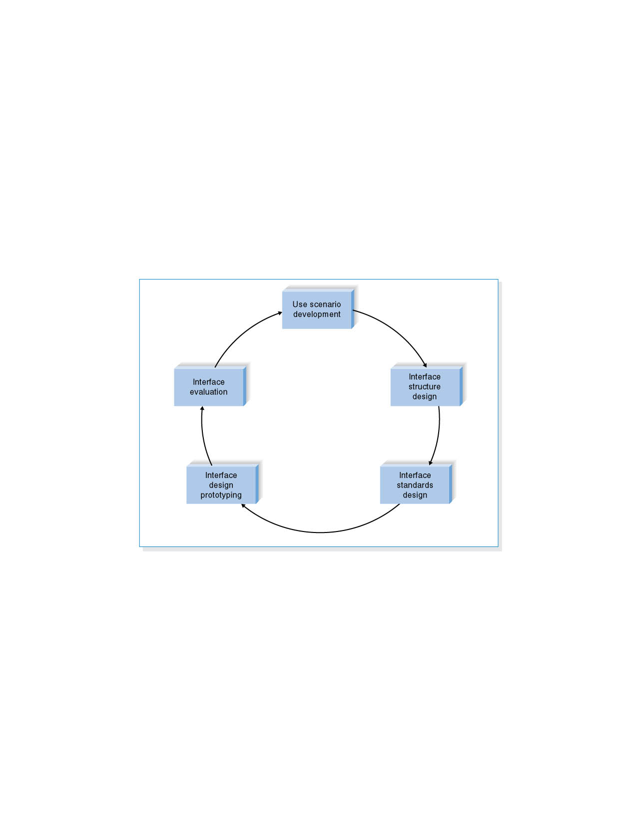
USER INTERFACE DESIGN PROCESS
User interface design is a five-step process that is iterative.

Slide 33
Program Design

Slide 34
Program Design
Program design – Analysts determine what programs will be written and create instructions for the programmers.
Various implementation decisions are made about the new system (e.g., what programming language(s) will be used.)
The DFDs created during analysis are modified to show these implementation decisions, resulting in a set of physical data flow diagrams.
The analysts determine how the processes are organized, using a structure chart to depict the decisions.
Detailed instructions called program specifications are developed.

Slide 35
Data Storage Design

Slide 36
Data Storage Design
The data storage function is concerned with how data is stored and handled by programs that run the system.
Data storage design is to
- select the data storage format;
- convert the logical data model created during analysis into a physical data model to reflect the implementation decision;
- ensure that DFDs and ERDs balance; and
- design the selected data storage format to optimize its processing efficiency.

Slide 37
DATA STORAGE FORMATS
There are two types of data storage formats:
- Files: electronic lists of data that have been optimized to perform a particular transaction.
- Database: a collection of groupings of information that are related to each other in some way.
A Database Management System (DBMS) is software that creates and manipulates the databases.
Notes:
A data file contains an electronic list of information that is formatted for a particular transaction.
Typically, files are organized sequentially.
Records can be associated with other records by pointers.

Slide 38
Databases
There are many types of databases:
- Legacy database
- Relational database
- Object database
- Multidimensional database
Notes:
The name of legacy database is given to those databases which are based on older technology that is seldom used to develop new applications.
Two major types of legacy databases:
- Hierarchical databases use hierarchies, or inverted trees, to represent relationships.
Network databases are collections of records that are related to each other through pointers.
--
The relational database is the most popular kind of database for application development today.
A relational database is based on collections of tables, each of which has a primary key.
The tables are related to each other by the placement of the primary key from one table into the related table as a foreign key.
The object database, or object-oriented database, is based on the premise of object orientation that all things should be treated as objects that have both data (attributes) and processes (behaviors).
Changes to one object have no effect on other objects because the attributes and behaviors self-contained, or encapsulated, within each one.
This encapsulation allows objects to be reused.
-----
A multidimensional database is a type of relational database that is used extensively in data warehousing.
Data warehousing is the practice of taking and storing data in a data warehouse (i.e., a large database) that supports decision support systems (DSS).
Data marts are smaller databases based on data warehouse data, and support DSS for specific departments or functional areas of the organization

